Slide 1

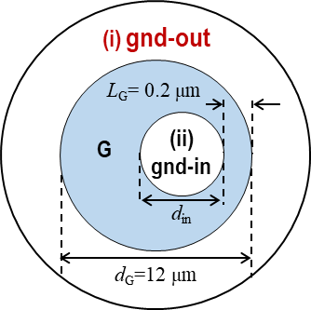
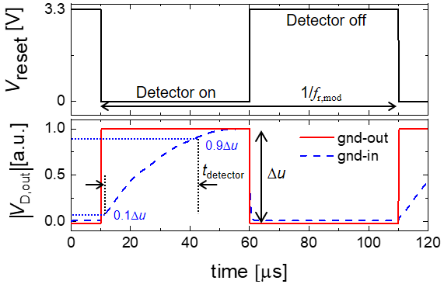
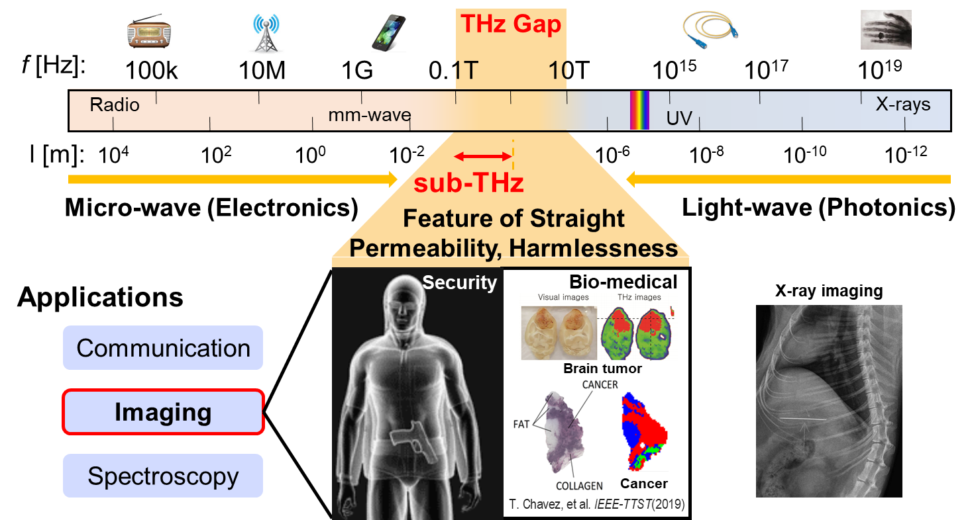
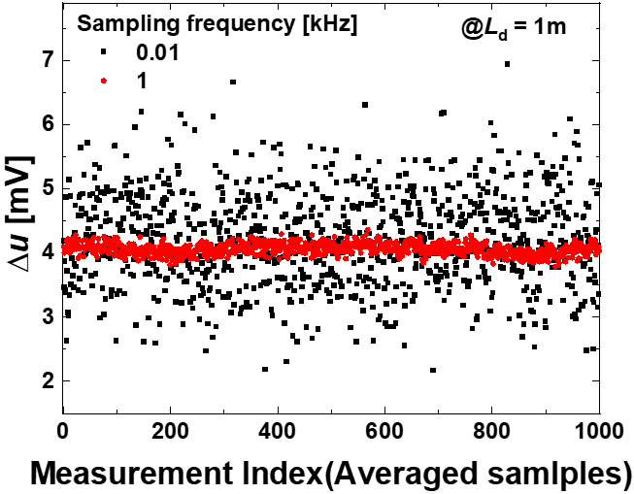
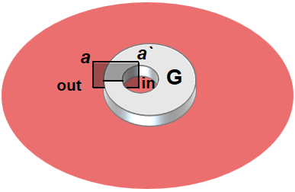
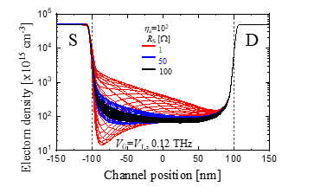
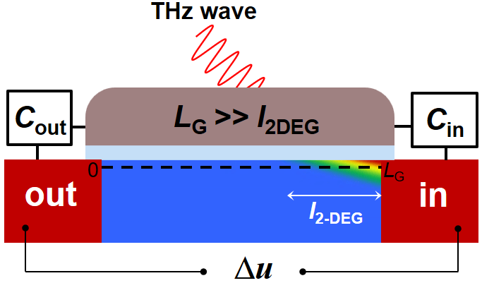
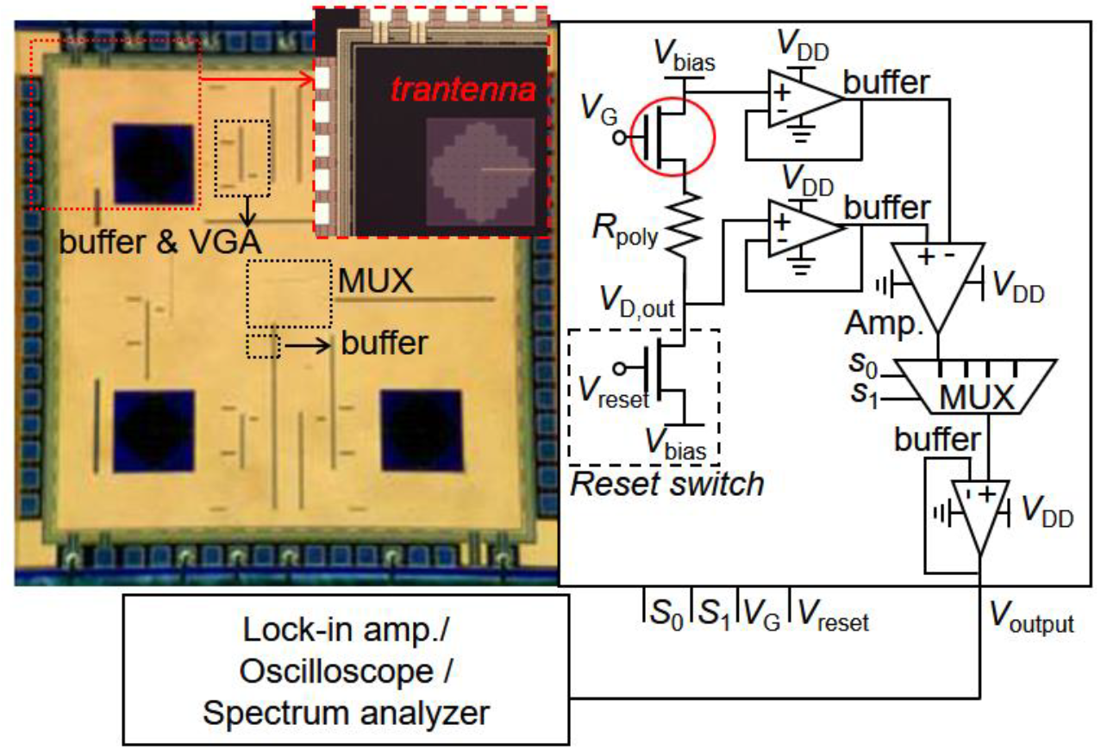
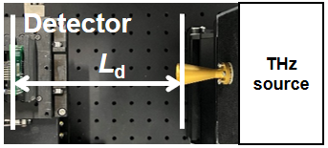
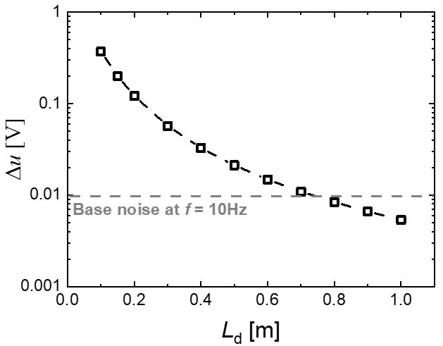
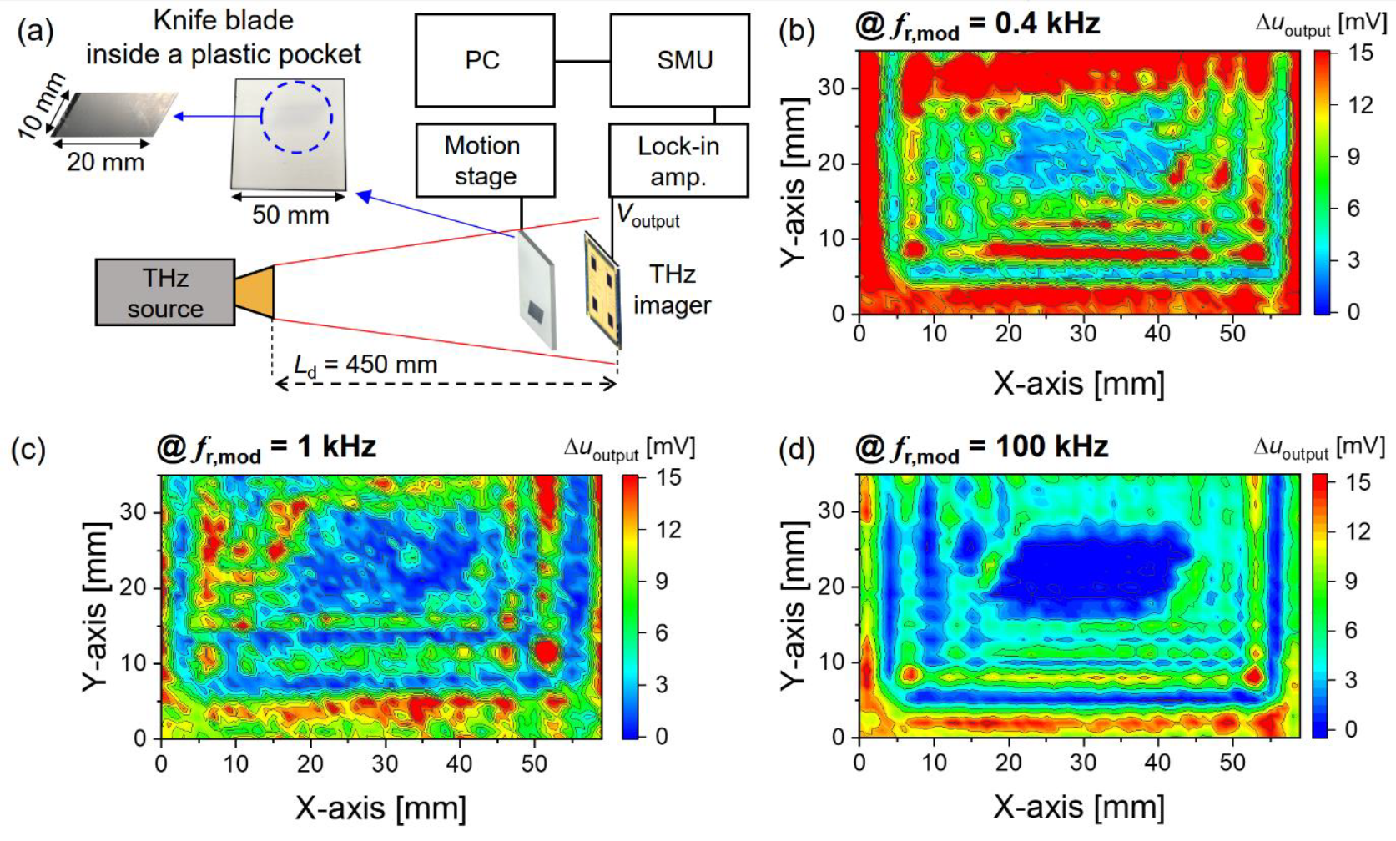
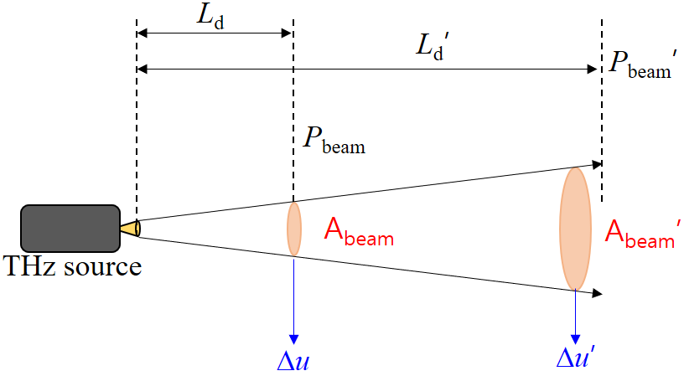
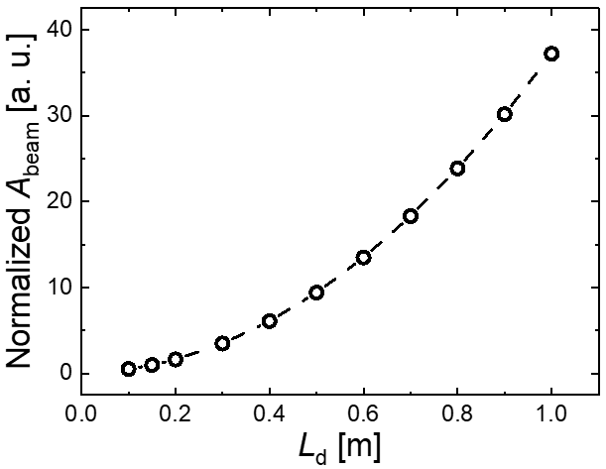
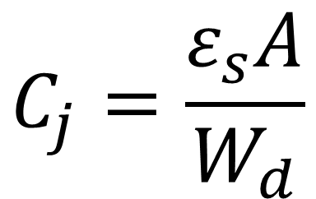
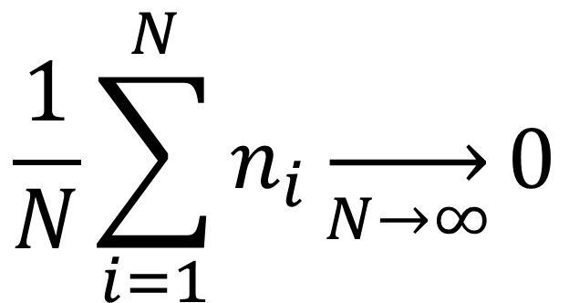
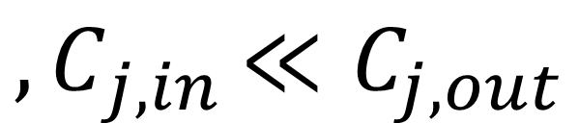
High-Speed Terahertz Detector for Large-Area Low-Noise Imaging System
Yoo Bin Song¹, Tae Hwan Hyeon¹, Gi Yong Lee¹, Min Woo Ryu¹ and Kyung Rok Kim^{1*}
¹Department of Electrical Engineering, UNIST, Republic of Korea
Abstract
High speed THz detector for low noise imaging
We present a high-speed terahertz (THz) detector for large-area, low-noise imaging under continuous-wave illumination at 0.1 THz, addressing signal degradation caused by beam divergence at extended stand-off distances. The detector response is synchronously read out under electrical modulation frequencies of 10 Hz and 1 kHz, where rapid temporal averaging of the channel output effectively suppresses random noise and significantly improves the signal-to-noise ratio (SNR). Experimental results demonstrate that high-speed readout combined with short-window averaging enables a practical and scalable approach for large-area THz imaging.
THz technology and plasmonic THz detector
$$C_{j}=\frac{ε_{s}A}{W_{d}}$$
$${,C}_{j,in}≪C_{j,out}$$
Comparison of gnd-in and gnd-out Trantenna configurations. By placing the ground terminal outside and using the inner terminal as the output, the output junction capacitance is reduced, enabling faster detector response and high-speed operation.
$$\frac{1}{N}\sum_{i=1}^{N}{n_{i}}\overset{→}{N→∞}0$$
(Noise averaging equation)
The terahertz (THz) frequency band is promising for imaging applications owing to its unique physical characteristics. For practical imaging applications, the capability to scan large areas is essential.
Monolithic
transistor + antenna
= Trantenna
in
out
Noise reduction enabled by high-speed operation through temporal averaging. For a fixed measurement duration, higher sampling frequency allows a larger number of samples to be acquired and averaged, resulting in a reduced noise level in the detector output.
a
a`
0
L_{G}
Schematic illustration of the THz detection mechanism based on asymmetric boundary conditions.Upon THz illumination, charge density oscillations in the 2DEG channel generate a voltage difference between the asymmetric terminals.
With increasing source–detector distance, beam divergence lowers the incident power, resulting in a detector output that can fall below the noise floor. Consequently, noise suppression is critical for reliable large-area THz imaging.
Demonstration of an on-chip THz imaging system enabled by a high-speed detector. The system successfully images a knife blade, confirming that high-speed operation allows practical THz imaging through effective signal acquisition and noise reduction.
Conclusion
A high-speed terahertz (THz) detector was demonstrated as an effective solution for large-area, low-noise THz imaging under long stand-off conditions. By adopting an asymmetric trantenna configuration with a gnd-out structure, the output junction capacitance was reduced, enabling fast readout and high-speed operation. This high-speed capability allows a larger number of samples to be acquired within a fixed measurement time, and temporal averaging effectively suppresses random noise even under reduced incident power caused by beam divergence. The proposed approach was further validated through an on-chip THz imaging system, successfully demonstrating knife-blade imaging and confirming its practicality and scalability for large-area THz imaging applications.

